Slide 1

Architecture Design Assistant Agent for IT Services
Neural Ninjas
Brijesh Rai
Divesh Yadav
Yogesh Mishra
Vaibhav Singh

Slide 2

Problem Statement
Main Challenge
Current Limitations
Designing IT system architectures involves multiple iterations and extensive collaboration between architects and stakeholders.
Existing methods rely on static architecture diagrams, complex manual tools, and lack advanced AI capabilities for dynamic generation or analysis.
The Need
A generative AI agent is needed to produce interactive architecture diagrams and intelligent component suggestions, streamlining the process and improving design quality.

Slide 3

Overview
The Architecture Design Assistant Agent is an AI-powered tool designed to accelerate IT architecture design. Its key capabilities include generating interactive architecture diagrams, providing intelligent component suggestions, and enabling seamless design iteration. This agent streamlines the design process, significantly improves architecture quality, and reduces manual effort for architects and stakeholders.

Slide 4




Solution
AI-Powered Diagram Generation
Interactive Design Iteration
Leverages pre-trained LLMs to generate architecture diagrams from textual requirements.
Conversational capability for refining and iterating on designs.
Multiple Output Formats
Template & Pattern Library
Downloadable images and editable diagram formats (Graphviz, PlantUML).
Built-in architecture templates and design patterns in JSON/XML format.

Slide 5
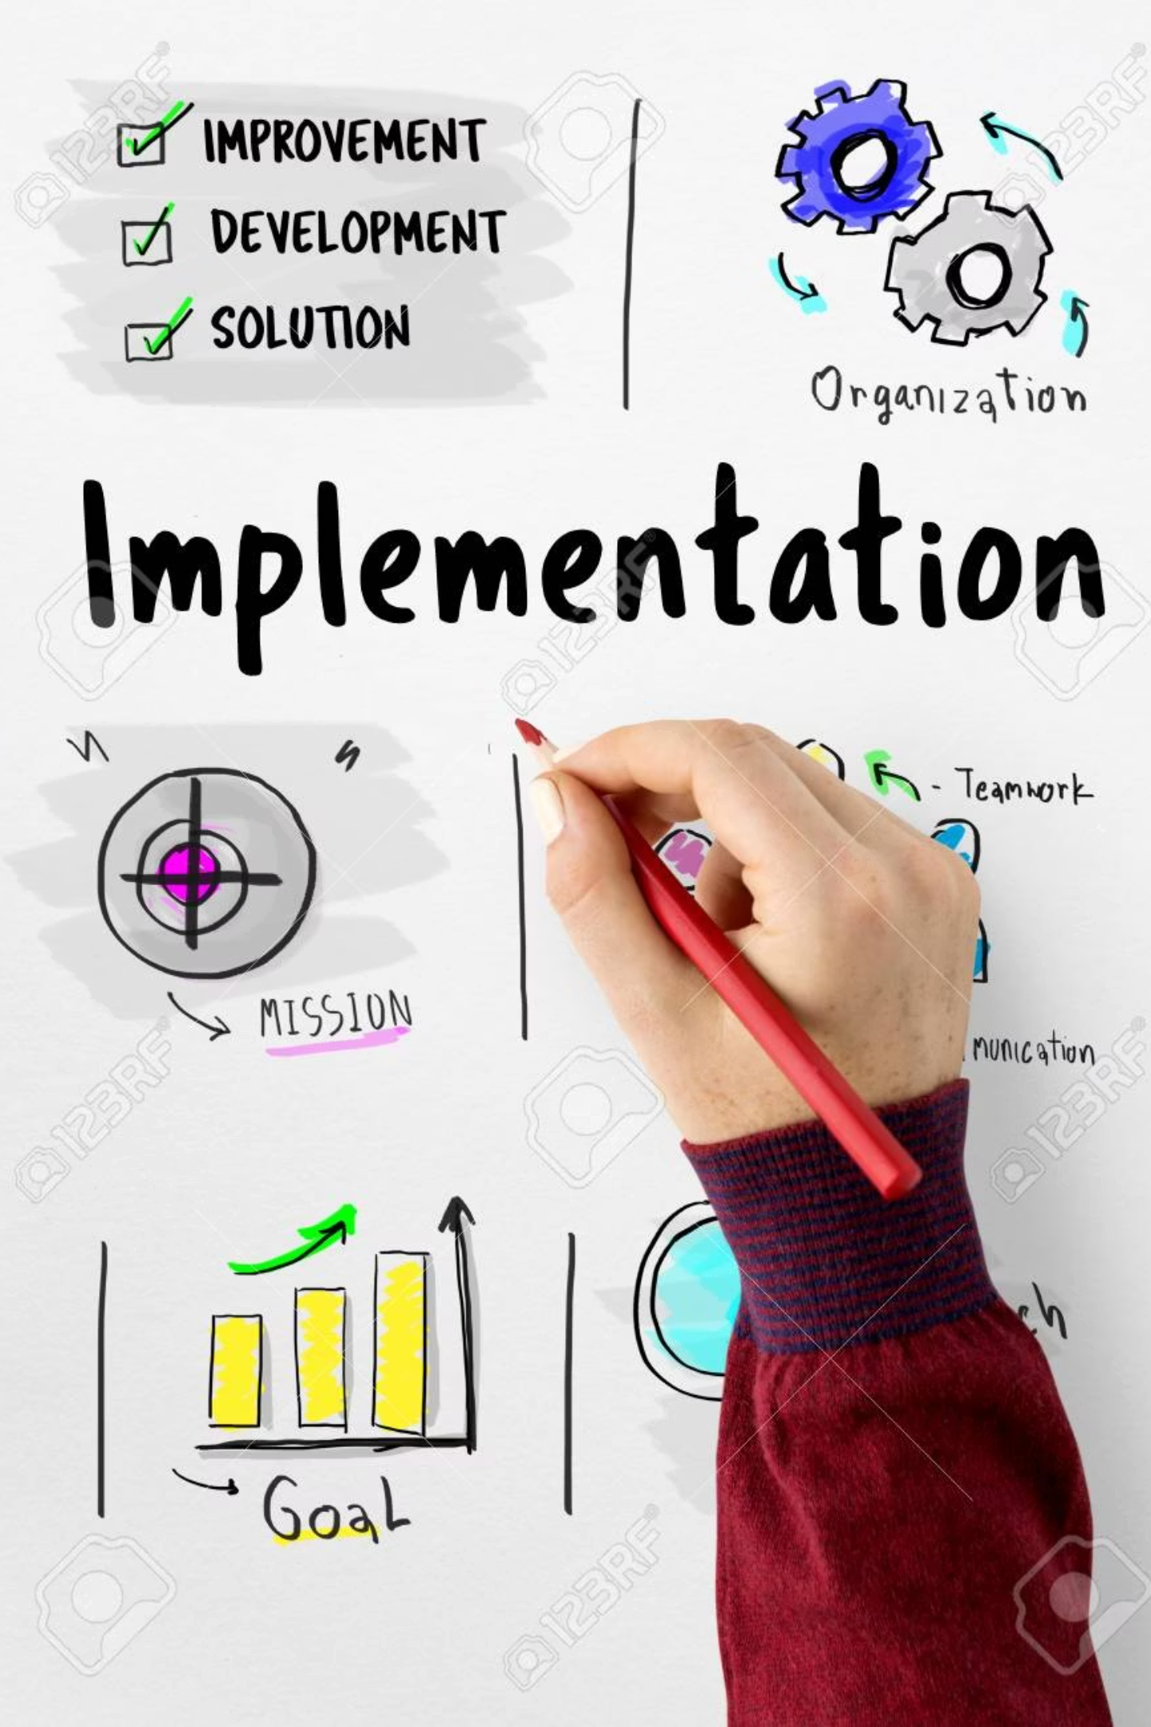
Implementation
01
LLM Integration & Setup
Setup LLM integration, implement diagram rendering libraries (Graphviz, PlantUML), and create the template repository.
02
Core Development
Build the conversational interface, develop architecture generation logic, and implement pattern matching capabilities.
03
Finalization & Deployment
Add export functionality, create UI/UX, conduct thorough testing and refinement, and prepare documentation.

Slide 6
Tech Stack Used
Our solution leverages a modern and robust technology stack designed for performance, scalability, and maintainability.
AI/LLM
Diagram Generation
Backend
OpenAI GPT-4
Graphviz
Python
LangChain
PlantUML
FastAPI
Hugging Face Transformers
Mermaid.js
Flask
Frontend
Data Formats
Deployment
React
JSON
Docker
TypeScript
XML
AWS/Azure
D3.js
YAML

Slide 7
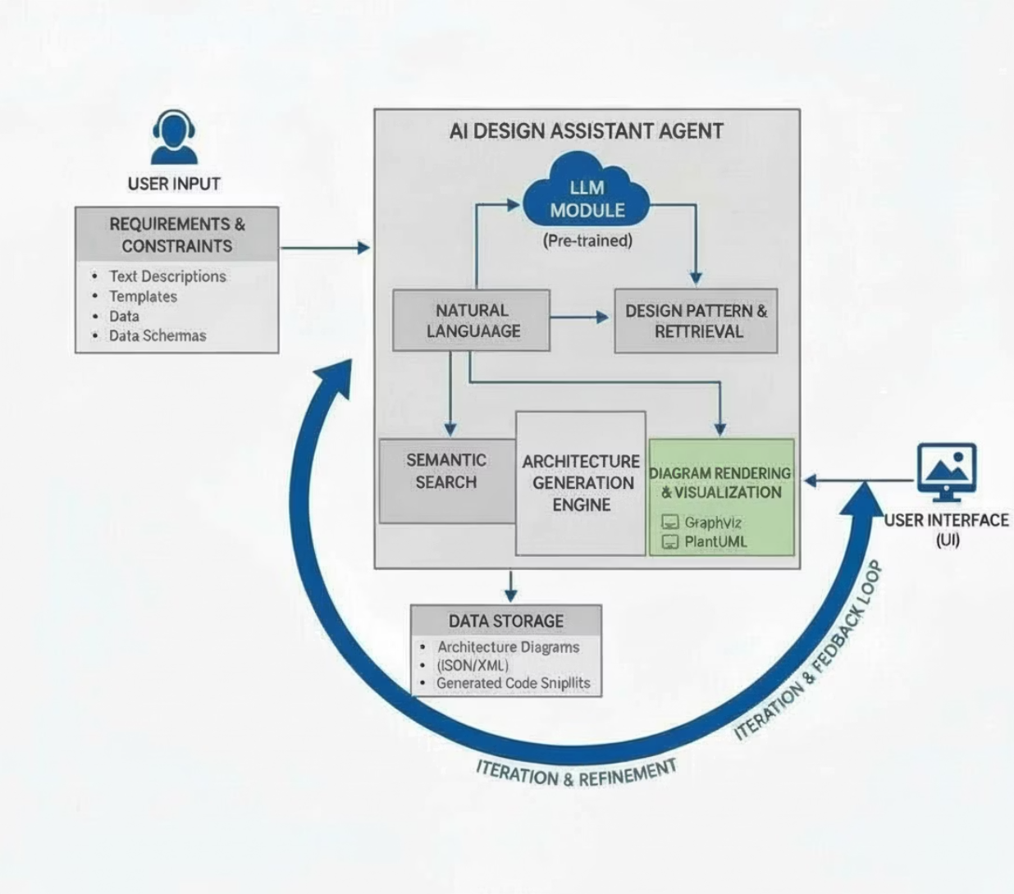

Solution Architecture
Our solution features a robust, layered architecture designed for clarity, efficiency, and scalability. This structure ensures a clear separation of concerns, with each layer fulfilling specific responsibilities and interacting through well-defined interfaces.

Slide 8

Future Scope
AI-Powered Enhancements
Collaboration Features
Extended Capabilities & Enterprise Integration
Next 6-9 Months
Next 9-12 Months
Advanced pattern recognition
Multi-user design sessions
Next 12-18 Months
Automated optimization suggestions
Version control
Cloud provider integration (AWS, Azure, GCP)
Real-time collaboration
Cost estimation integration
Compliance checking
Security analysis
API for CI/CD pipelines
Integration with existing design tools
Custom template creation

Slide 9

Conclusion
The Architecture Design Assistant Agent accelerates the design process with AI automation, improves quality through best practices, and enables interactive collaboration. It provides flexible output formats and showcases a practical application of generative AI in IT services, delivering significant benefits for architecture design.

Slide 10

Thank You
Questions & Discussion

